Slide 1


Customization Patterns
Esri Developer Summit
March 8–11, 2016 | Palm Springs, CA
Wolf Kaiser
Notes:
Ask Wolf for updated PPT.

Slide 2
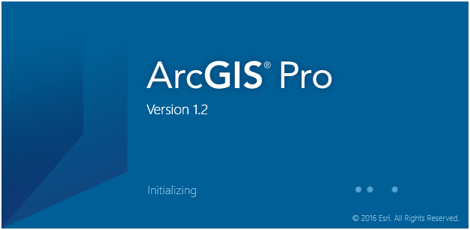
Important Customization Patterns for the Pro SDK
Coarse grained and Fine grained APIs
Hooking Commands
MVVM

Slide 3
ArcGIS Pro Internal Threading Model
ArcGIS Pro is multi-threaded
incorporates the latest asynchronous language features from Microsoft
Implements a threading infrastructure tailored to reduce complexity.
Add-In developers should only need to contend with two threads:
The GUI thread
A single specialized worker thread called the Main CIM Thread, MCT
Internally, ArcGIS Pro uses a large number of threads for:
Rasterization, rendering, data loading, GP
Isolated from the API
Pro delegates to the internal threads on the API’s behalf.
Simplifies coding, ensures consistency of Pro state.
Notes:
Esri engineers have placed a high priority on making ArcGIS Pro as easy to program against as possible in the new multithreaded architecture. To this end…
MCT is a good acronym to remember (e.g. for exceptions)

Slide 4
Four Key Differences When Developing for Pro versus Desktop
The Graphical User Interface (GUI) thread must remain responsive and be free to take user input
Users must always be presented with a logically consistent and informative user interface.
Including when background processes are running.
If a long running operation is logically cancellable, an option to cancel should be offered
Conflicting operations should not be executed simultaneously, and should always be performed in an appropriate logical sequence
Eg a delete of selected features cannot execute until the select has completed
Access to shared state between threads is properly synchronized

Slide 5
Three Categories of Methods in ArcGIS Pro API
Coarse-grained asynchronous methods:
Can be called on any thread
Finer grained synchronous methods:
Must be called within a QueuedTask
Non-API “.NET” methods can be called on System threads as you wish
Synchronous methods:
Must be called on the GUI thread only
These types of methods are usually associated with WPF and UI updates

Slide 6
Coarse Grained Methods
Can be called from any thread. Typically invoked from the UI thread
They execute in the background on Pro internal threads
Use async/await semantic
Aggregation of these methods into larger coarse grained async methods is not encouraged
//Adding a Geodatabase:
string gdbPath = "@C:\\myDataFolder\\myData.gdb";
var newlyAddedGDB = await Project.Current.AddAsync(ItemFactory.Create(gdbPath));
//Execute a GP Tool
await Geoprocessing.ExecuteToolAsync("SelectLayerByAttribute_management",
new string[] {"parcels","NEW_SELECTION", "description = 'VACANT LAND'"});
await MapView.Active.ZoomToSelectedAsync(new TimeSpan(0, 0, 3));
Notes:
Select Layer By Attribute
http://resources.arcgis.com/en/help/main/10.1/index.html#/Select_Layer_By_Attribute/001700000071000000/
await keyword – task returned waits for results to complete (e.g. a GP operation)

Slide 7
Fine Grained, Synchronous Methods
Must be called within a QueuedTask
A much greater number of fine grained methods and classes
No async/await. Runs on the MCT
Designed for aggregation into your own coarse-grained async methods
await ArcGIS.Desktop.Framework.Threading.Tasks.QueuedTask.Run(() =>
{
var layers = MapView.Active.Map.FindLayers("Parcels")
.OfType<FeatureLayer>().ToList();
var parcels = layers[0] as FeatureLayer;
QueryFilter qf = new QueryFilter()
{
WhereClause = "description = 'VACANT LAND'",
SubFields = "*"
};
parcels.Select(qf, SelectionCombinationMethod.New);
});
Notes:
Demo – coarse grained + fine grained method

Slide 8
Using QueuedTask
Pro framework’s custom Task scheduler.
Used to run synchronous ArcGIS Pro SDK methods in the background
These synchronous methods are listed in the API Reference guide like this:
“This method must be called on the MCT. Use QueuedTask.Run”
Example of synchronous methods in Pro: GetSpatialReference, QueryExtent, SetDefinition (members in FeatureLayer class)
Task t = QueuedTask.Run(() =>
{
// Call synchronous SDK methods here
});
Notes:
MCT = main CIM thread
CIM = Cartographic Information Model.

Slide 9
Coarse grained / fine grained demo
Notes:
Remember fine grained can only be run on main thread.
Coarse grained can combine fine grained and run asynchronously.

Slide 10
Hooking Commands
Get any Pro control’s ICommand and use it in your add-in using Framework’s “GetPlugInWrapper” method.
Following example shows how a Pro control’s command can be added to your add-in button click method. (or anywhere else in your add-in).
// ArcGIS Pro's Create button control DAML ID.
var commandId = DAML.Button.esri_mapping_createBookmark;
// get the ICommand interface from the ArcGIS Pro Button
// using command's plug-in wrapper
// (note ArcGIS.Desktop.Core.ProApp can also be used)
var iCommand = FrameworkApplication.GetPlugInWrapper(commandId) as ICommand;
if (iCommand != null)
{
// Let ArcGIS Pro do the work for us
if (iCommand.CanExecute(null))
iCommand.Execute(null);
}
Notes:
ArcGIS.Desktop.Core.ProApp derives from FrameworkApplication
System.Windows.Input.ICommand

Slide 11
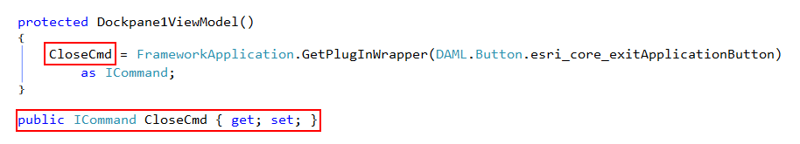
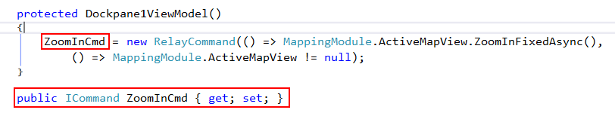
Hooking Commands
Adding a button to the Dockpane to run the ‘Close ArcGIS Pro’ Command
Adding a button to the Dockpane with our ‘custom’ Zoom in behavior
RelayCommand is an implementation of ICommand which lets you specify your own implementation of Execute and CanExecute
Notes:
RelayCommand takes two parameters, where you define your implementation of Execute and CanExecute (? Right ?) API function.

Slide 12
MVVM Pattern in Add-ins
MVVM and variants are de-facto pattern for WPF UI implementations
Many Frameworks available
Home grown or “hand rolled”
Commercial (free, purchased)
Pro MVVM is built on top of ActiPro (http://www.actiprosoftware.com/products/controls/wpf )
The Basic Pattern is:
ViewModel declared in DAML and implemented in code
View referenced in DAML and implemented as WPF UserControl
Model is optional
Note: To customize the Pro UI, you must use its MVVM Framework. Substitutes are not allowed.
Notes:
MVVM = Model View, View, Model

Slide 13
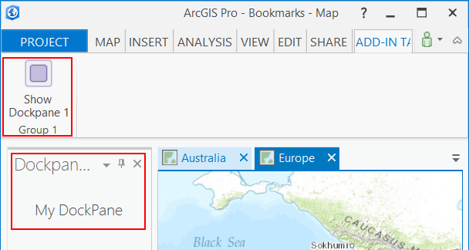
MVVM Pattern in Add-ins
Model-View-ViewModel (MVVM) Pattern used for many of the Framework elements
Dockpane
Pane
Custom Control
Property Page
Notes:
Create new Module ….
Rename the tab …
Add a dockpane and debug
… show config . Daml
Show mvvm viewmodel and view classes stubbed out.

Slide 14
MVVM - Pane
Many instances
Has Default Tab and Default Tool association – “context”
In Pro, Panes should be exposed by static class Properties:
MapView.ActiveView (Layout.ActiveLayout – doesn’t exist!, etc)
Can be discovered by FrameworkApplication.Panes.ActivePane, FrameworkApplication.Panes.FindPane(paneID)
<panes>
<pane id="custom_Pane" caption=“Custom View" className=“CustomViewModel"
isClosable="true" defaultTab=“custom_PaneTab" defaultTool=“custom_PaneTool">
<content className=“CustomPaneView"/>
<optionsMenu refID=“customPaneMenu"/>
</pane>
</panes>
Notes:
Suitable for use when a pane should have a special application context - eg hosts content that has an associated ribbon or functionality.
When it is activated it controls what is available on the ribbon
Can also have an associated menu via the optionsMenu element
Has dedicated pane on the status bar, this pane is controlled through the UpdateStatusPane member on the View class
Pane vs. Docking Pane – different. Docking pane is a singleton, not destroyed only hidden.

Slide 15
MVVM – Dockpane
Singleton
Has no context association with the ribbon and no active tool
Once created only hidden, never destroyed
View Model derives from the DockPane Contract
View is Custom User Control associated with DockPane declaratively
(Use of Model is optional and completely up to developer)
<dockPanes>
<dockPane id="custom_TOCDockPane" caption="My Contents""className="DockPaneViewModel"
dock="group“ condition="esri_core_MapPane"" dockWith="esri_core_ProjectDockPane">
<content className="DockPaneView""/>
</dockPane>
</dockPanes>
Notes:
Framework instantiates your Dockpane and ensures the View Dataconext is set to the DockPane View Model. Should be the most commonly used pane for 3rd parties.
Access via FrameworkApplication.DockPaneManager.Find(_dockPaneID);
Navigate_Pane_DockPane demo

Slide 16
Navigate_Pane_DockPane demo sample

Slide 17
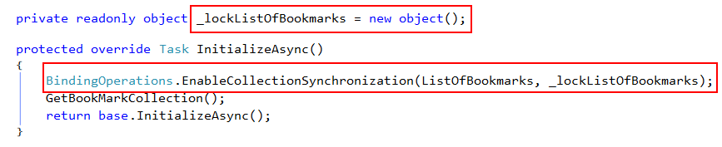
Multi-threading considerations
ArcGIS Pro Framework’s managed threading model:
Framework provides QueuedTask to guarantee that UI actions happen in a sensible order without corruption
Updating UI collections from a worker thread
Locking is required when sharing objects across threads
Recommended pattern for updating collections from a worker thread
Found in .Net BindingOperations helper class: BindingOperations.EnableCollectionSynchronization
Notes:
Missing slide: can initialize plug in in background async.
Locking allows worker thread to update data without any penalty.

Slide 18
Demo Updating UI collections from a worker thread

Slide 19




